Slide 1


Applications Revenue Analysis
Modern Data Management and Business Intelligence
By Dimitris Matsanganis & Fotini Nefeli Nouskali
Professor: Mr. Damianos Chantziantoniou

Slide 2

Business Case
IT company with the ambition to be expanded to the mobile application market and more specifically, to the android app market.
Some categories considered to have a great impact and commercial interest are proposed by the IT company to analysts’ team.
The analysts’ team investigate and evaluate the mobile app genres that belong to the most commercially successful ones and the business investment in one of these would be valid.
The target genres’ categories are seven.
Tools, Education, Health & Fitness, Music & Audio, Finance, Business, Sports.

Slide 3


Specification criteria for the dataset selection
Dataset size exceeding the 300,000 rows
More than 3 categorical variables that will constitute the dimensions of the database schema and have enough factors to make aggregations to present in our business case
Enough quantitative variables to be used as metrics in order to have a crucial base to create new measures to express a different perspective from the one the dataset initially offers
Combination of categorical and numerical variables that present opportunities for unpivot, drill up and drill down or hierarchical decomposition in case of categorical variables
Interesting content that depicts business needs

Slide 4

Dataset presentation
Variables description
350.000 rows presenting 19 variables with 12 numerical metrics and 7 categorical ones
Information contained is about applications genre, performance in installation status, prices, in application purchases, reviews, and ratings
The dataset includes information for mobile applications available on Google Play Store
The applications included belonging to different types and present development trends.

Slide 5








Cleaning Stages
Initial Not Cleaned CSV
String values into numeric vectors
Different currencies - metrics
Empty rows associated with the App Name
non-ASCII characters …
Remove the rows with empty App Name
Adjust the dataset by removing and renaming columns in a more representative and formal manner
Separate In App Purchases to MIN & MAX columns
Separate Cost to isFree & Price columns
Remove string values from numeric columns (eg. total at the end of installations & reviews, Size column to numeric without ‘M’ and ‘k’)
Convert currencies to € (remove currency sign $ ₫)
Use its filters for evaluation
Remove the non-ASCII characters
Final Cleaned CSV

Slide 6
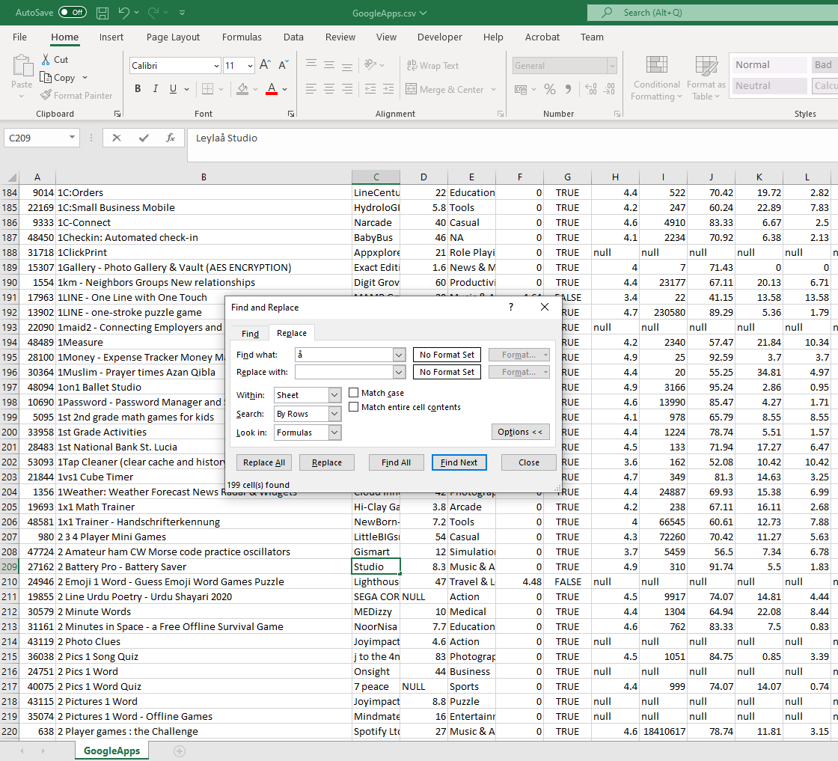

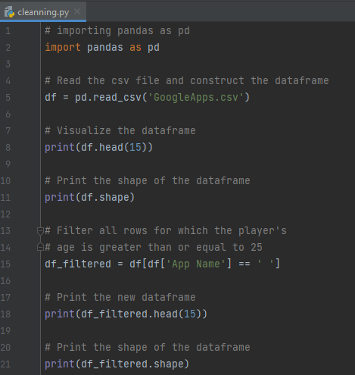
Cleaning examples in Python & Excel
Deletion of the rows with empty Application Name field with Python’s Pandas library
Removal or replacement of a non-ASCII character in MS Excel with the Find and Replace function.

Slide 7
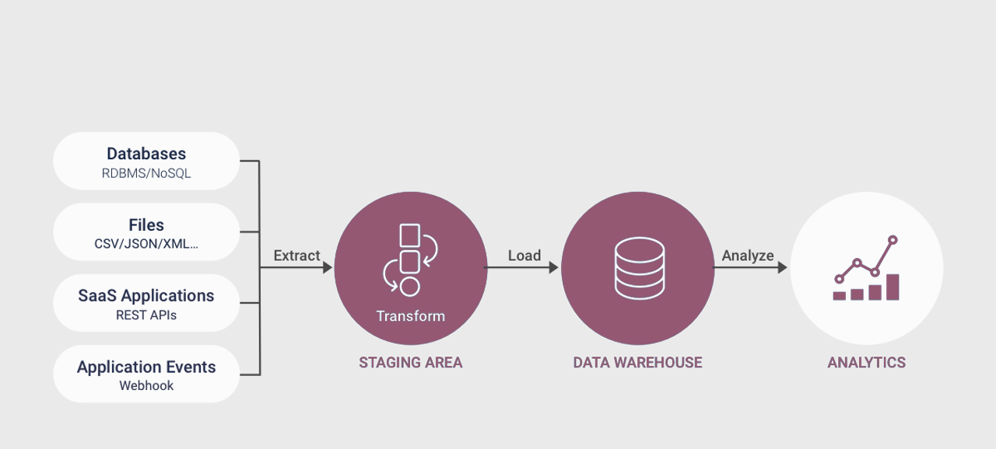
ETL Process

Slide 8



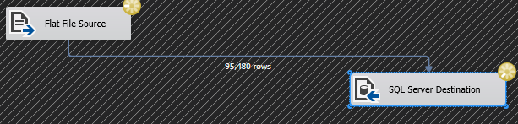
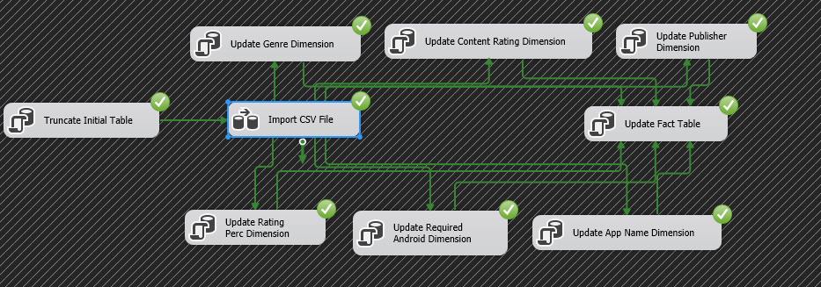
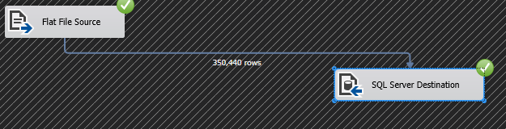
ETL Process
Data Flow
Control Flow

Slide 9

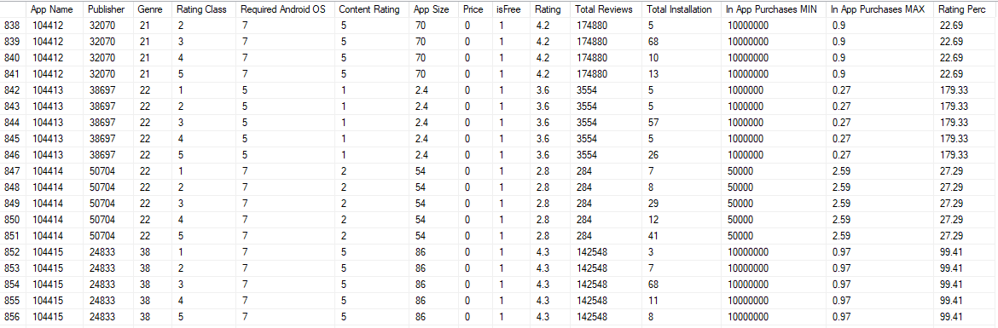
ETL Process
Fact Table

Slide 10

OLAP Cube - Multidimensional Model

Slide 11




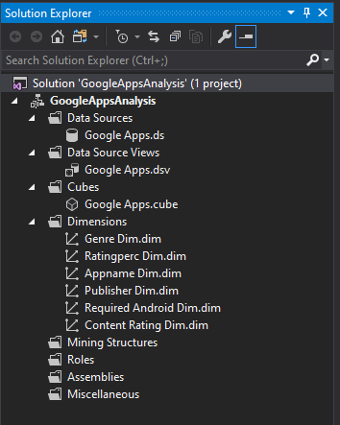
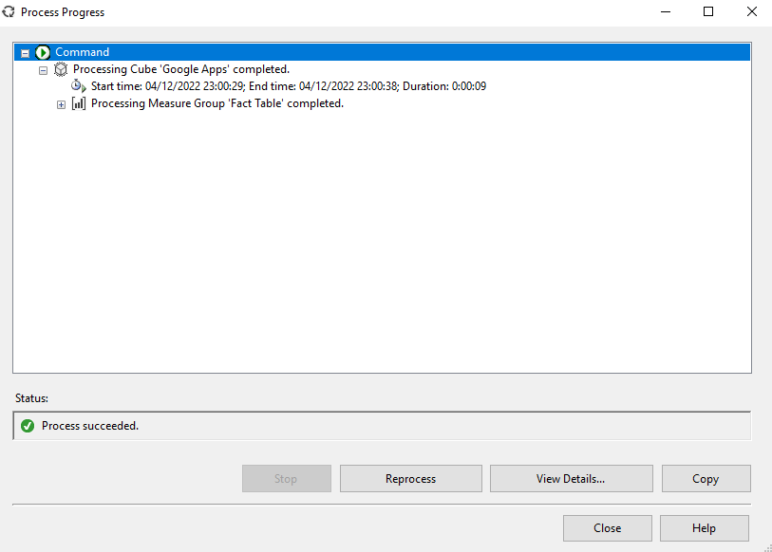
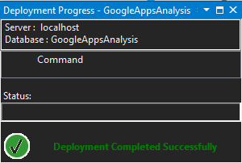
OLAP Cube
Deployment Progress
Process Progress
Solution Explorer

Slide 12

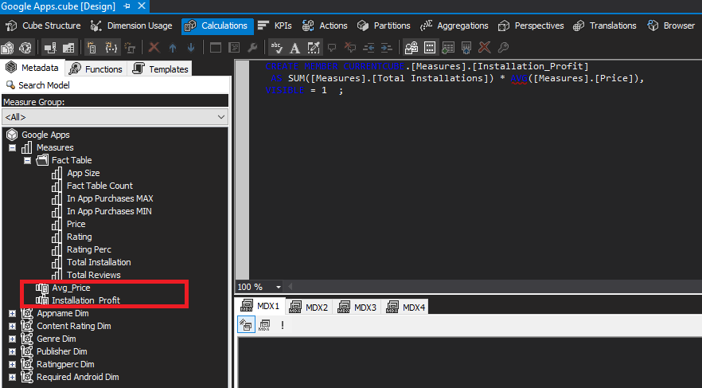
OLAP Measures
Two OLAP Measures
Avg_Price
Installation_Profit

Slide 13

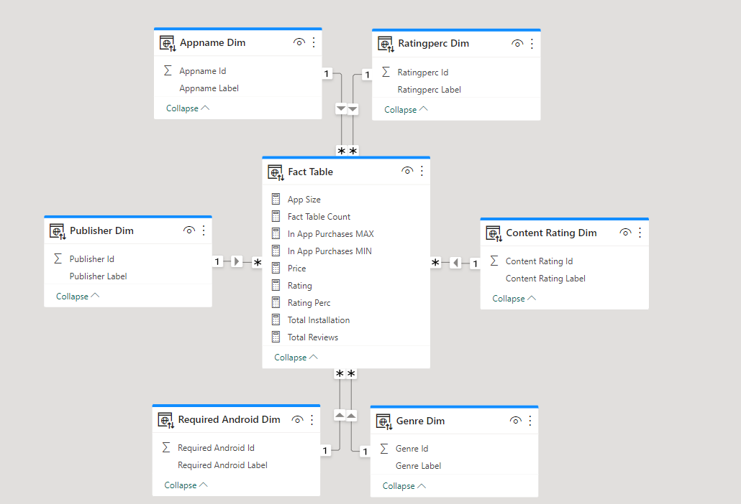
Database Schema

Slide 14







Analysis Results
Five Reports
Popularity Analysis
Rating Performance
Profit Sources Analysis
Free and Paid Apps Profits
Key Profitability Indicators

Slide 15
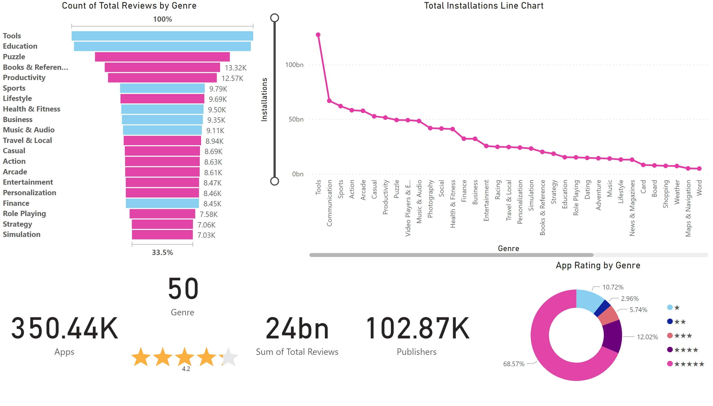
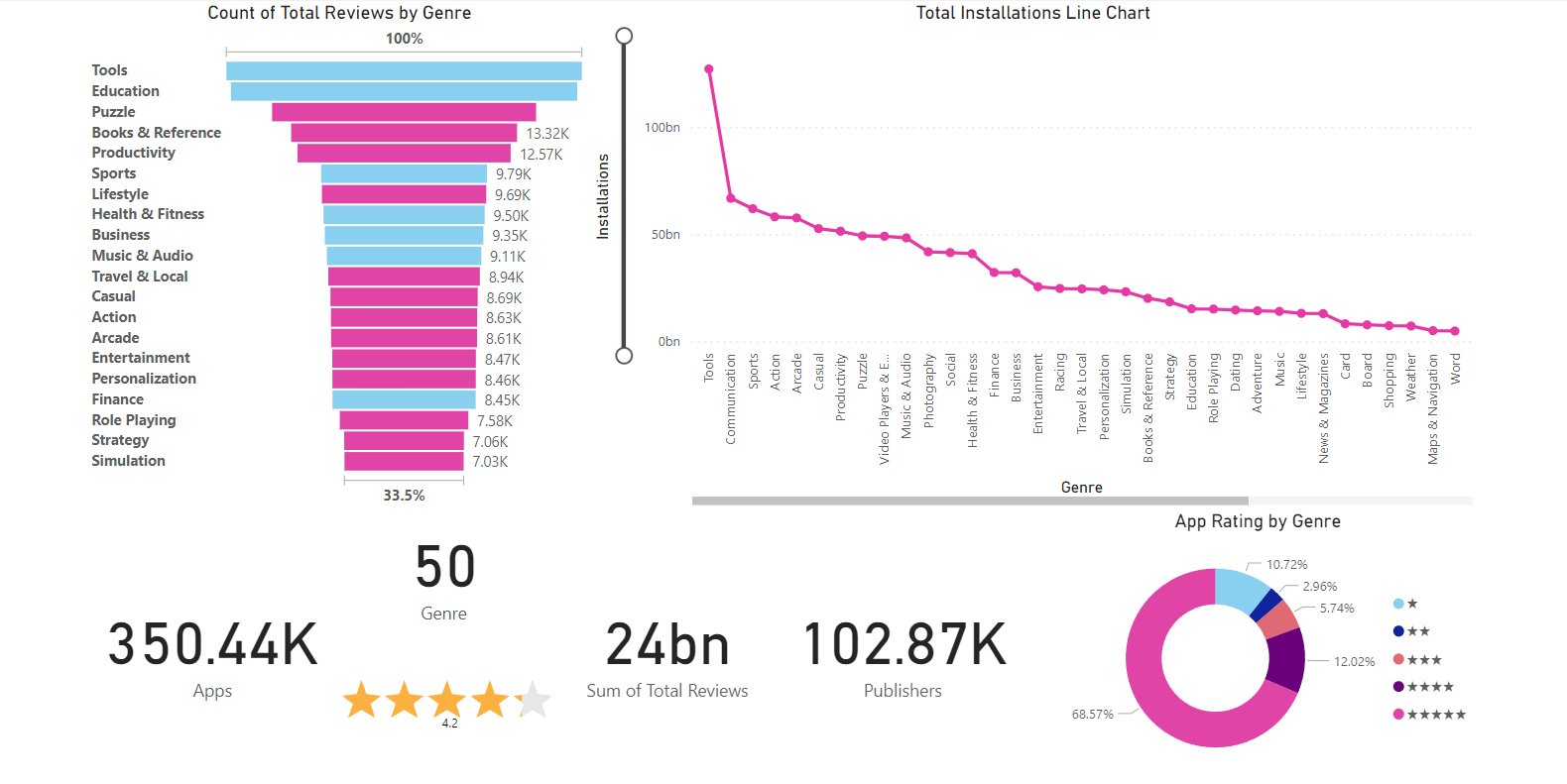

Slide 16
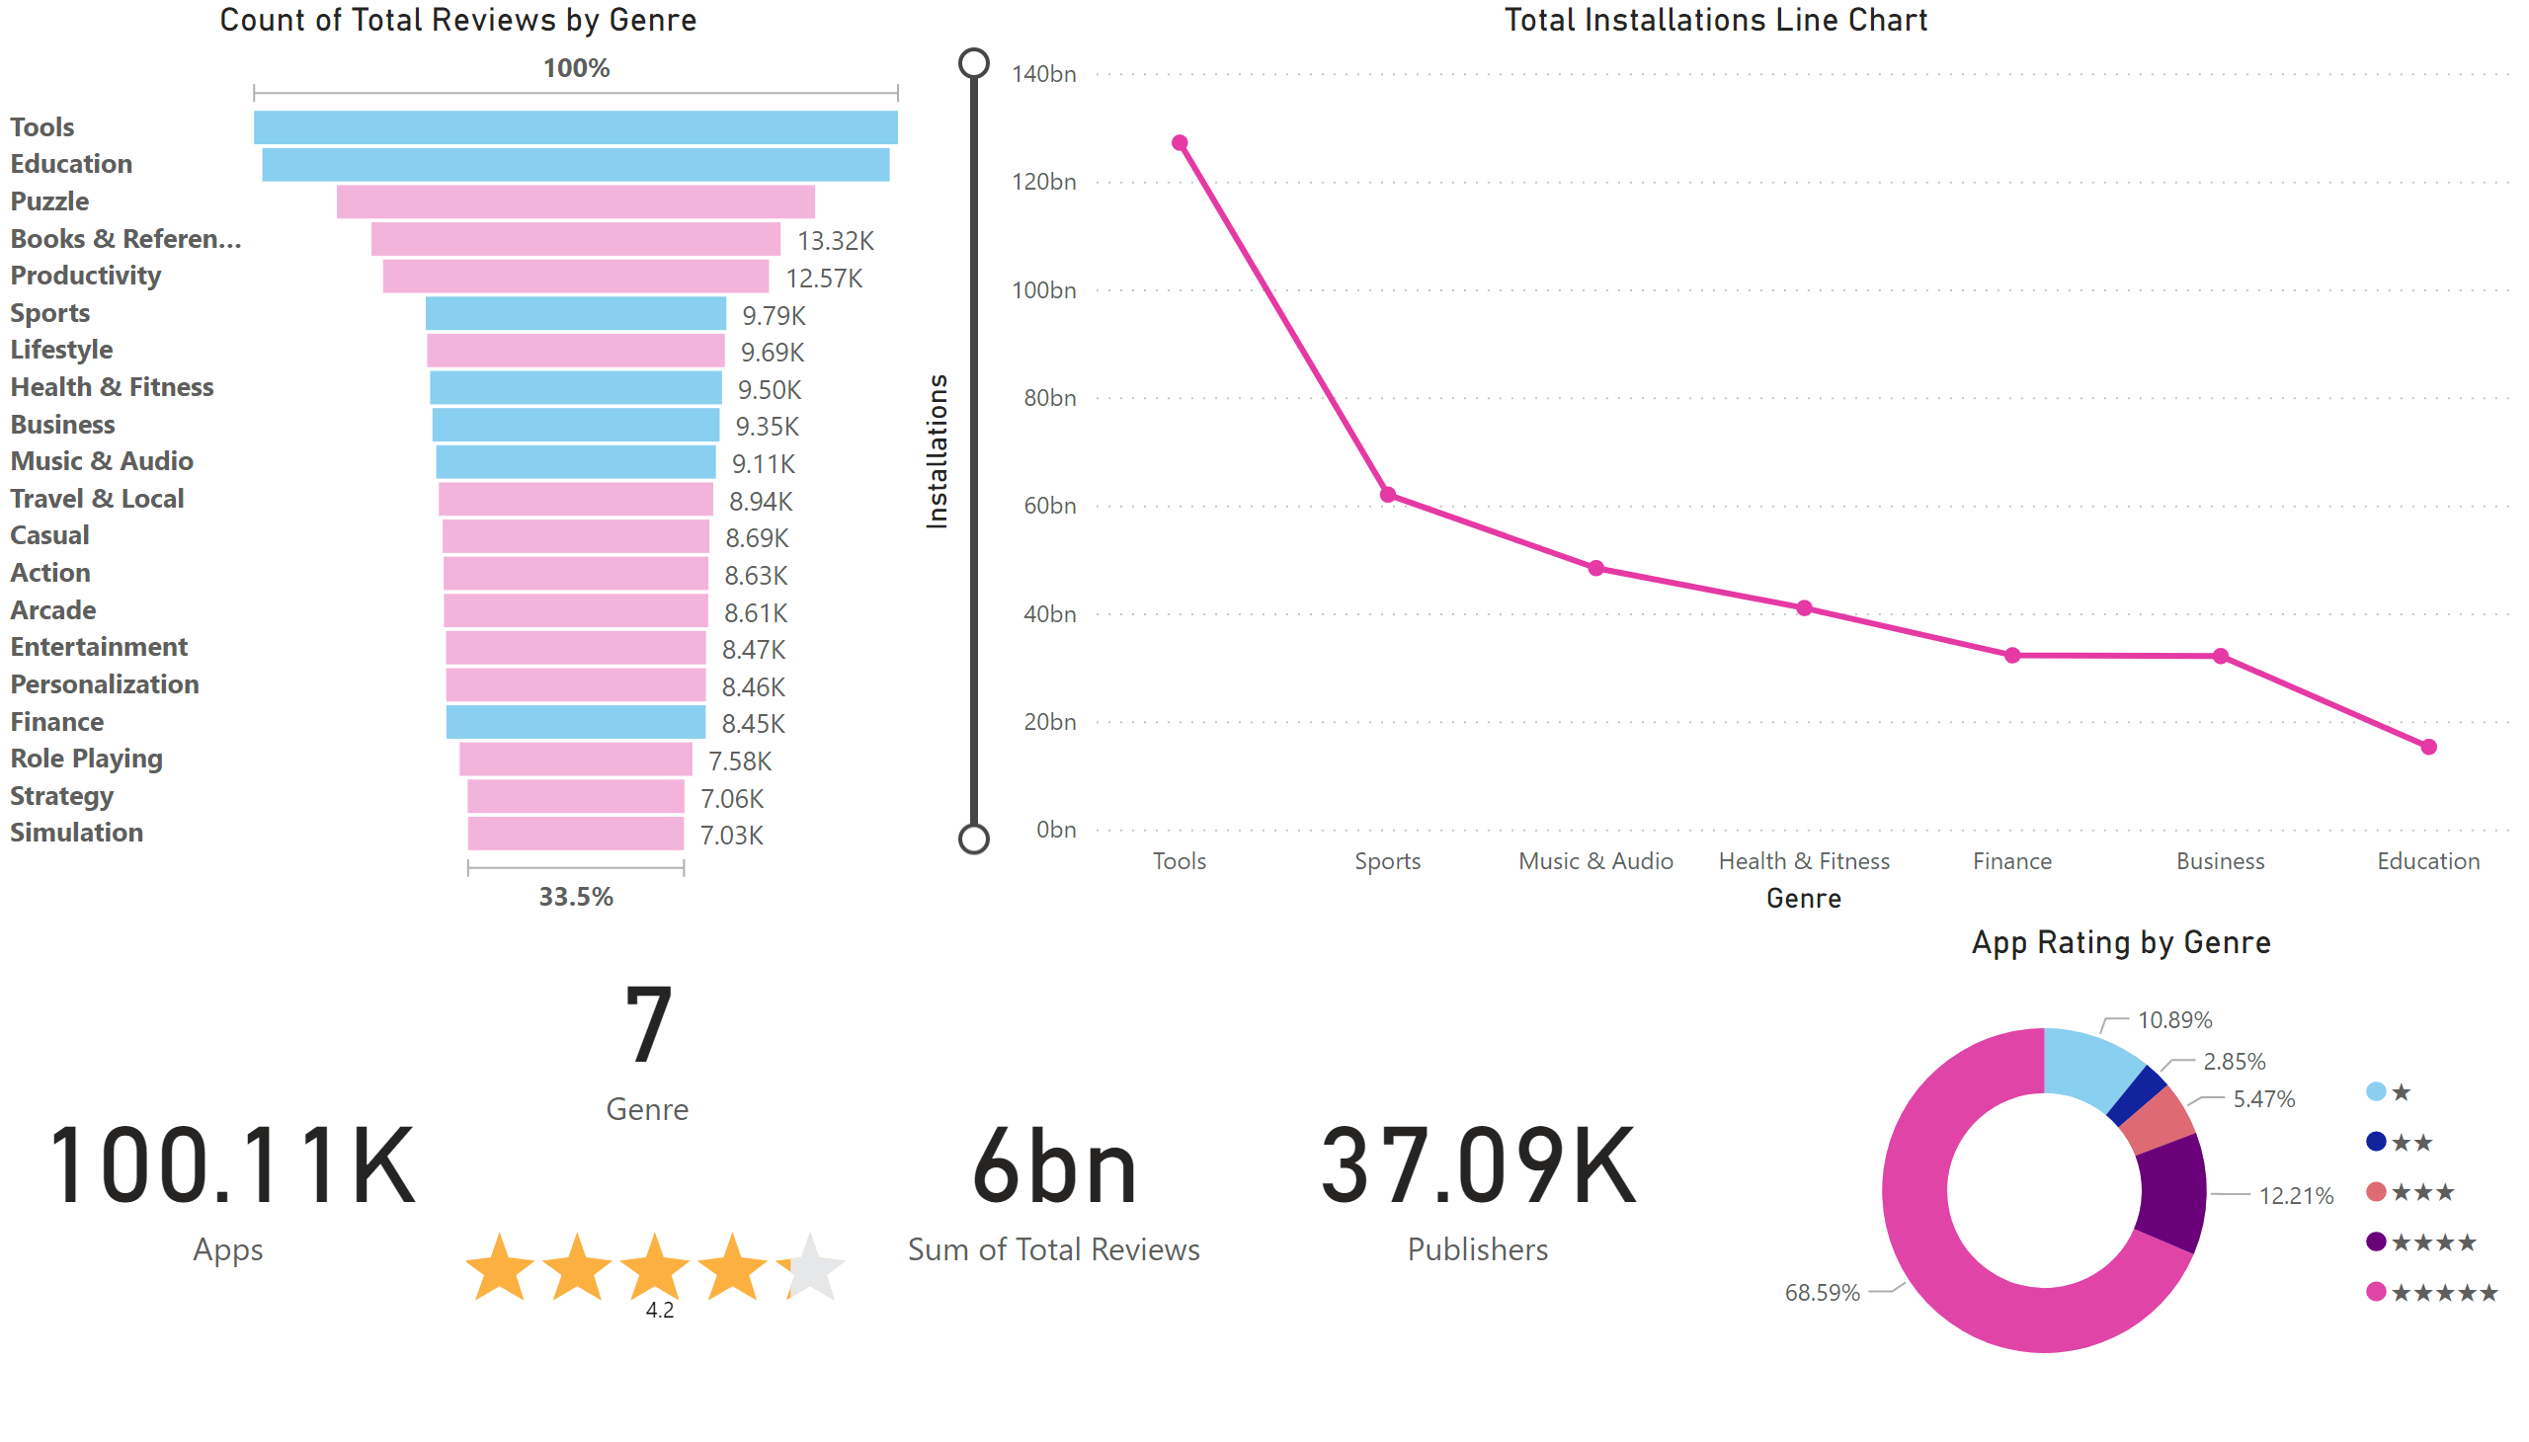
First Page
Notes:
funnel
No alt text provided
Total Installations Line Chart
No alt text provided
card
No alt text provided
card
No alt text provided
card
No alt text provided
App Rating by Genre
No alt text provided
PBI_CV_9053509D_D461_463A_B485_CE9F6AB0F13D
No alt text provided
card
No alt text provided

Slide 17
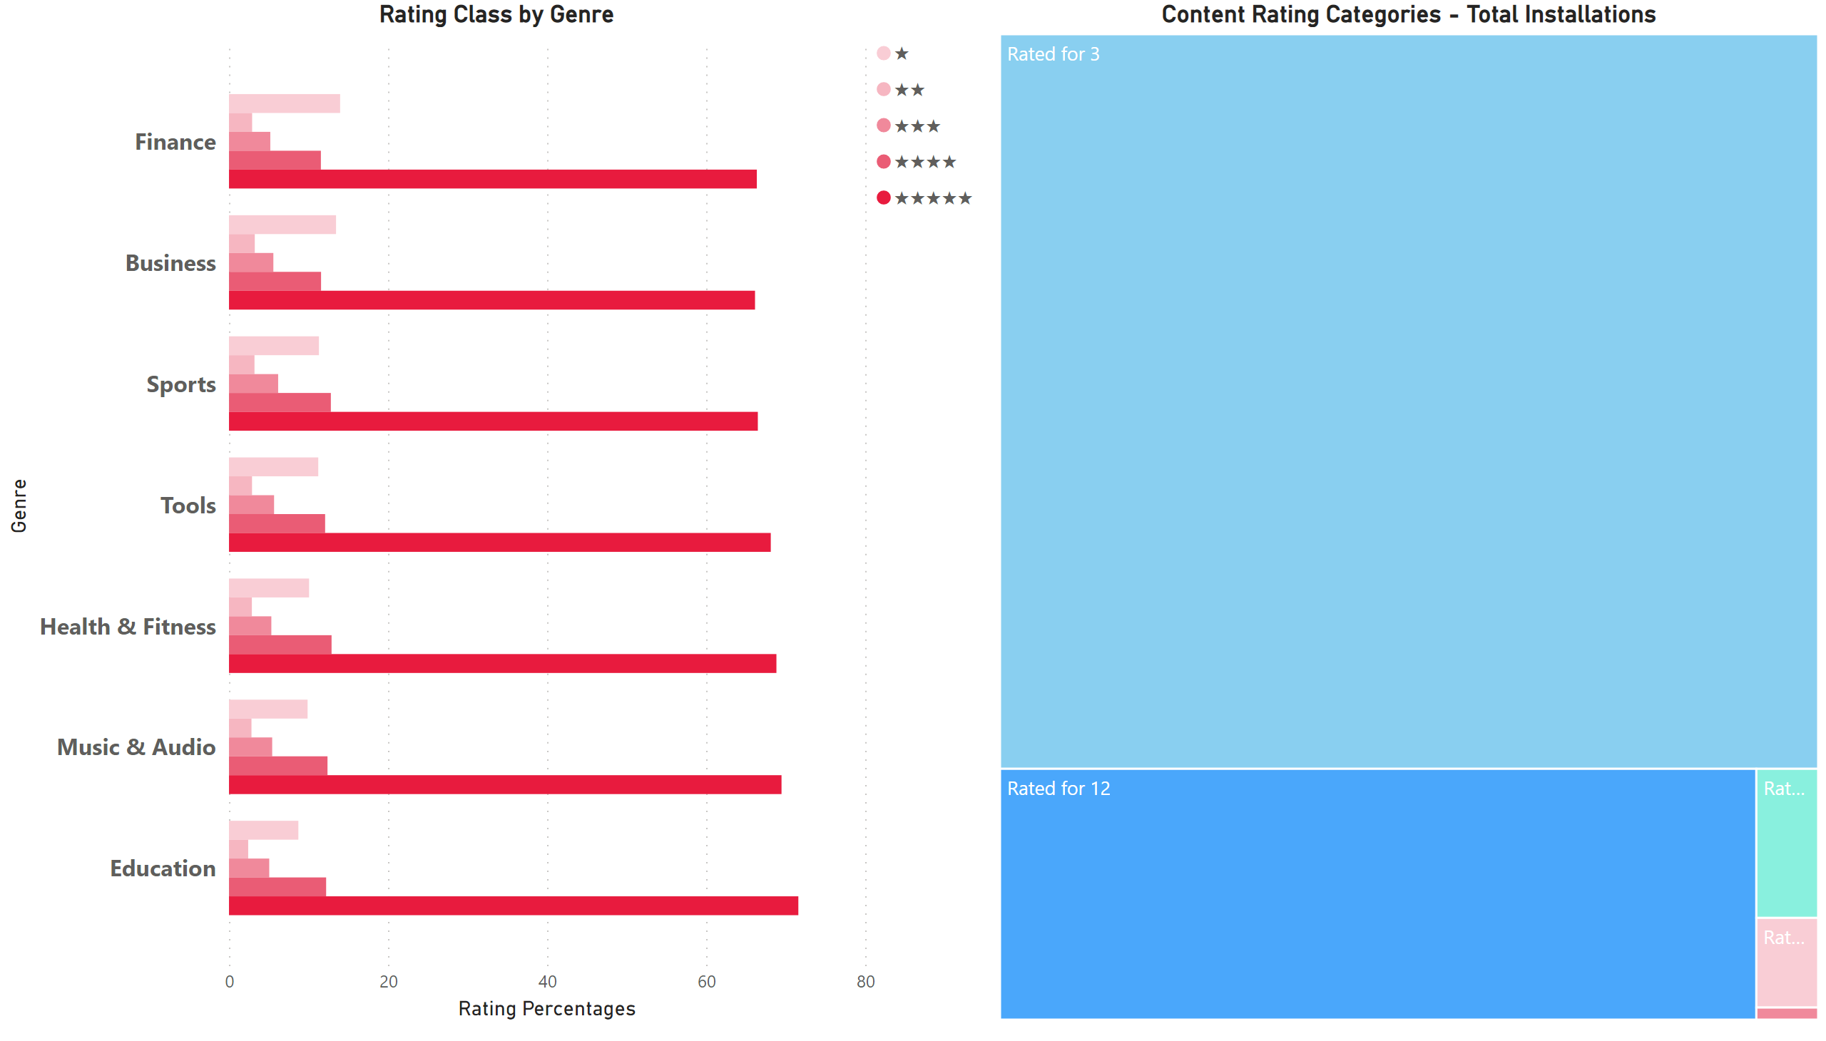
Genre Rating
Notes:
Rating Class by Genre
No alt text provided
Content Rating Categories - Total Installations
No alt text provided

Slide 18
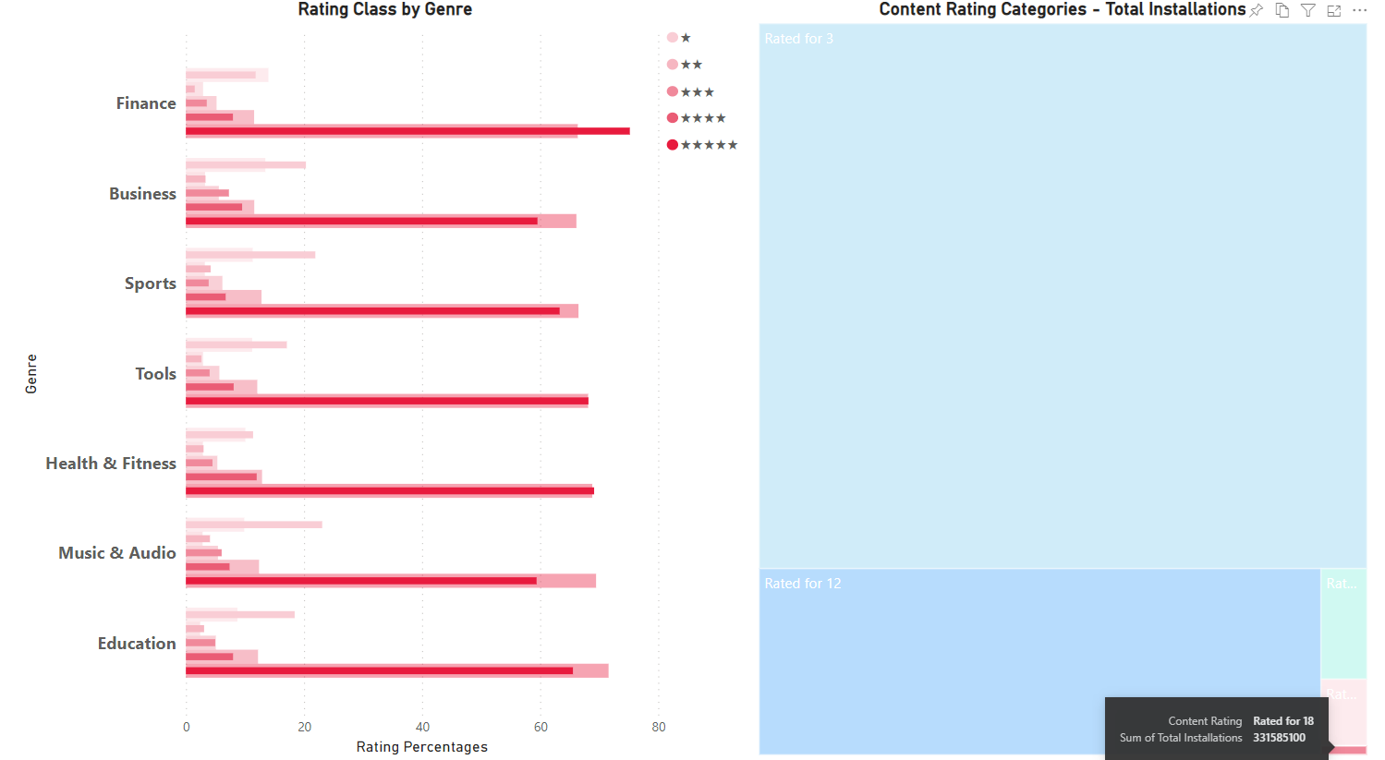

Slide 19
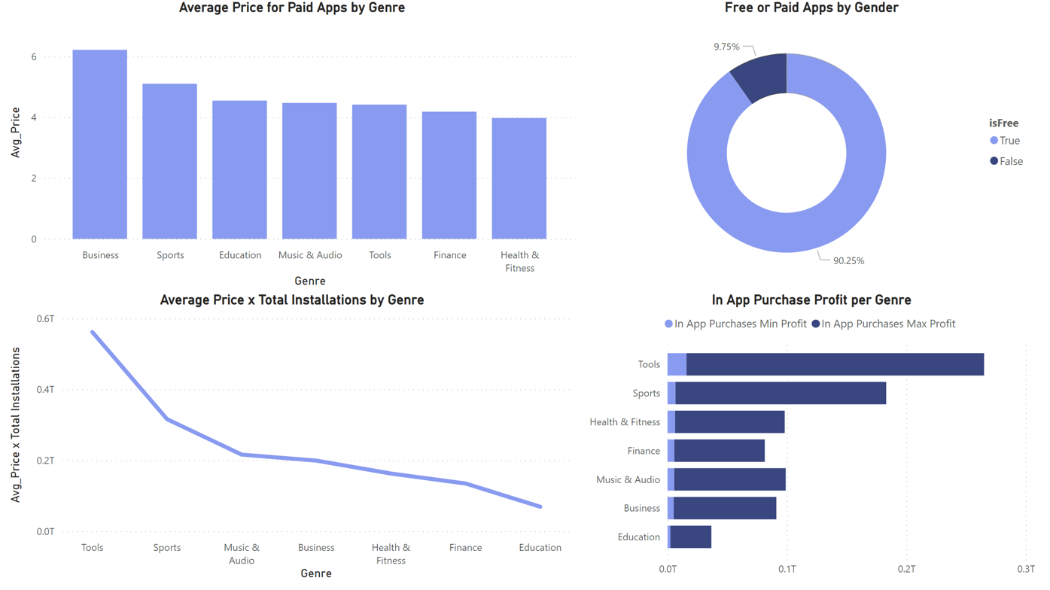
Dash 3 - Profit Sources
Notes:
Free or Paid Apps by Gender
No alt text provided
Average Price for Paid Apps by Genre
No alt text provided
Average Price x Total Installations by Genre
No alt text provided
In App Purchase Profit per Genre
No alt text provided

Slide 20
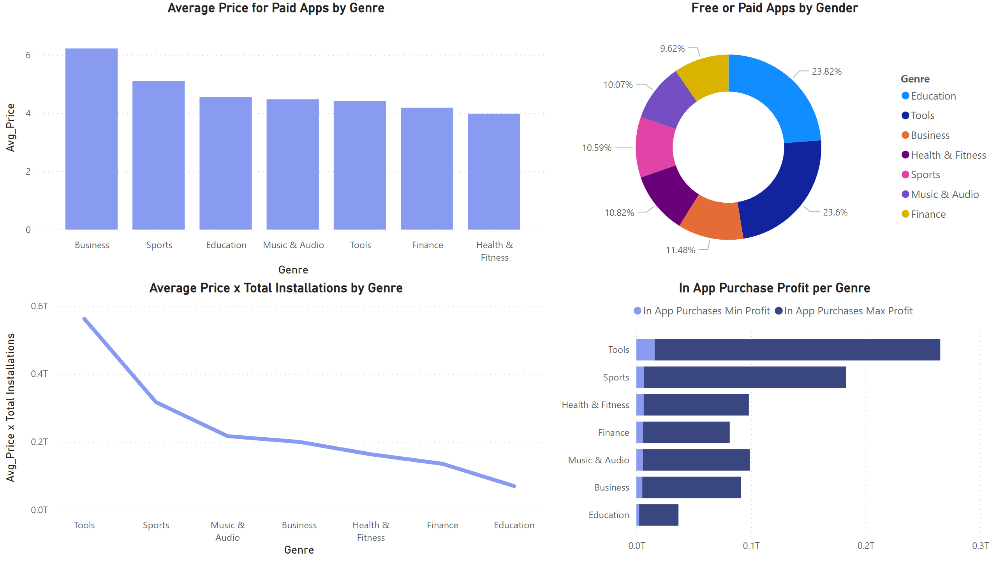
Dash 3 - Profit Sources
Notes:
Free or Paid Apps by Gender
No alt text provided
Average Price for Paid Apps by Genre
No alt text provided
Average Price x Total Installations by Genre
No alt text provided
In App Purchase Profit per Genre
No alt text provided

Slide 21
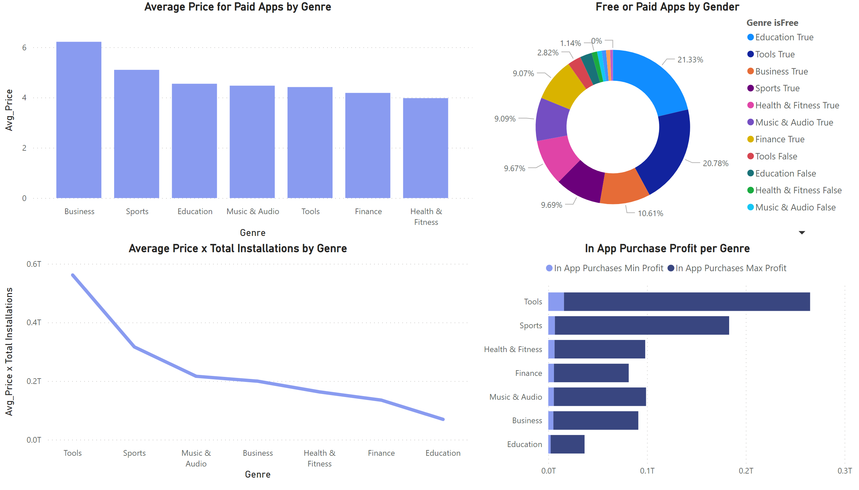
Dash 3 - Profit Sources
Notes:
Free or Paid Apps by Gender
No alt text provided
Average Price for Paid Apps by Genre
No alt text provided
Average Price x Total Installations by Genre
No alt text provided
In App Purchase Profit per Genre
No alt text provided

Slide 22
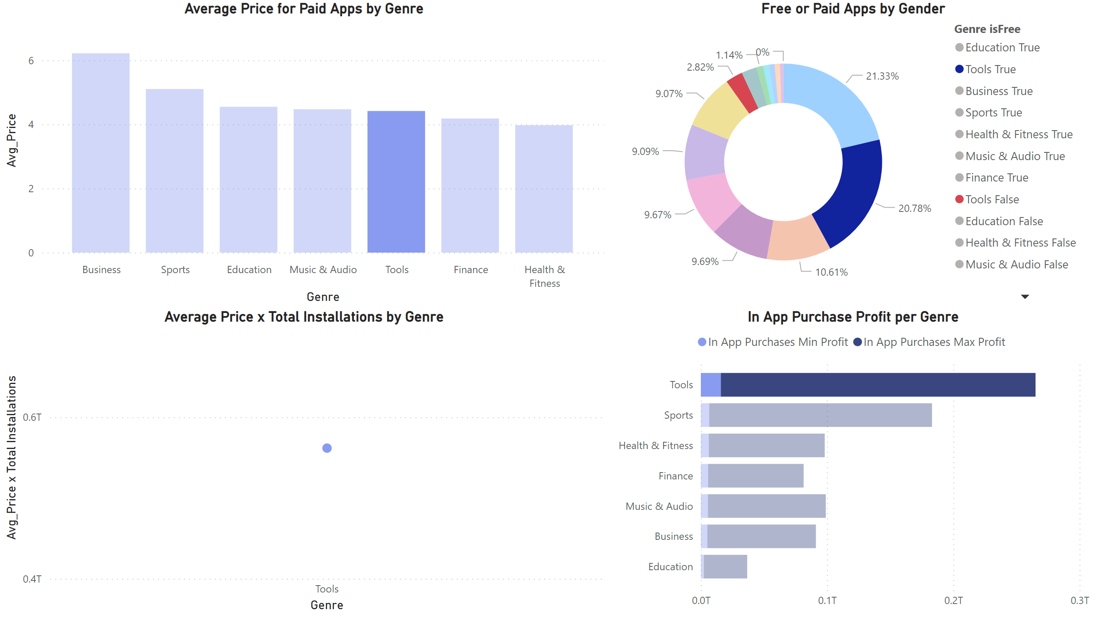
Dash 3 - Profit Sources
Notes:
Free or Paid Apps by Gender
No alt text provided
Average Price for Paid Apps by Genre
No alt text provided
Average Price x Total Installations by Genre
No alt text provided
In App Purchase Profit per Genre
No alt text provided

Slide 23
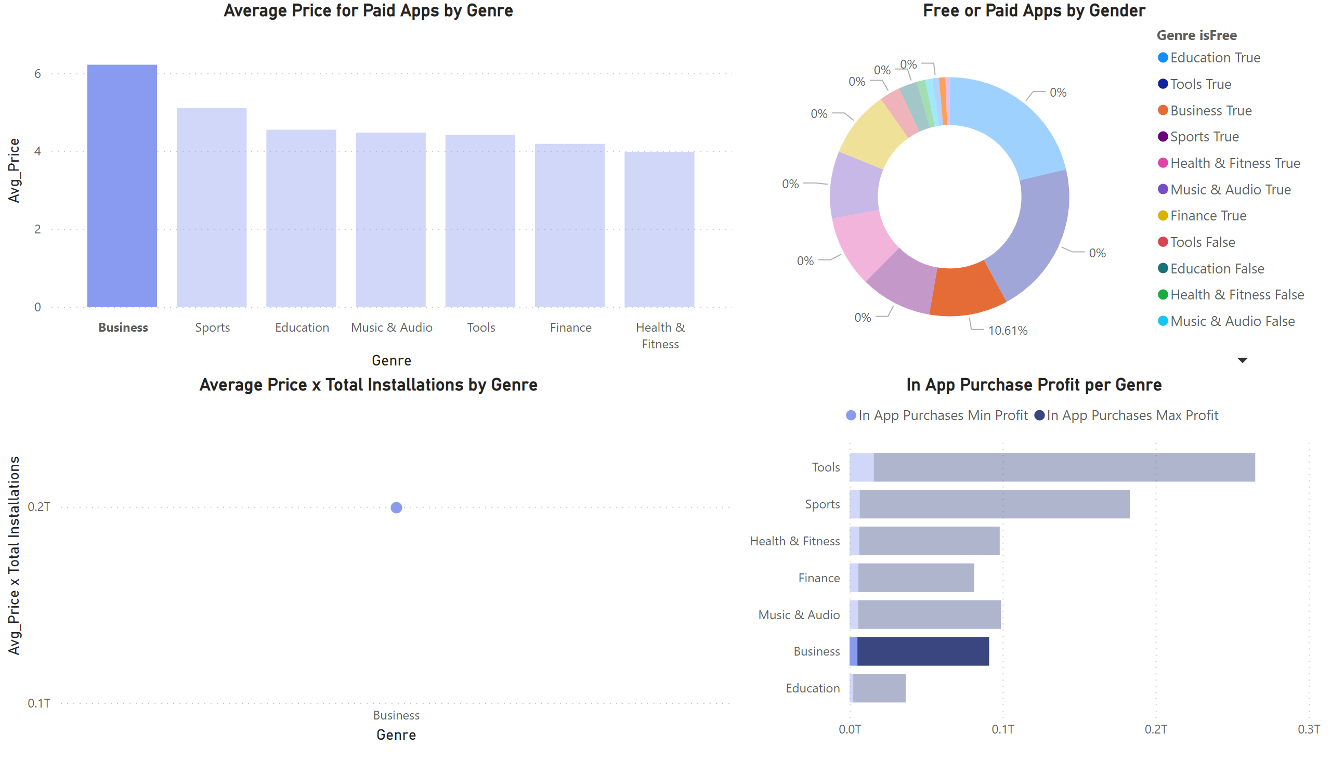
Dash 3 - Profit Sources
Notes:
Free or Paid Apps by Gender
No alt text provided
Average Price for Paid Apps by Genre
No alt text provided
Average Price x Total Installations by Genre
No alt text provided
In App Purchase Profit per Genre
No alt text provided

Slide 24
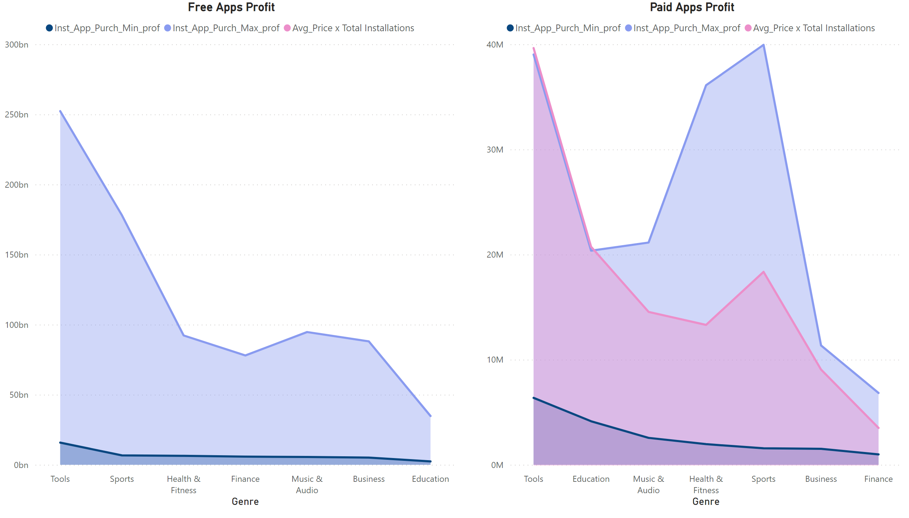
Dash 4 - Apps Profit
Notes:
Paid Apps Profit
No alt text provided
Free Apps Profit
No alt text provided

Slide 25
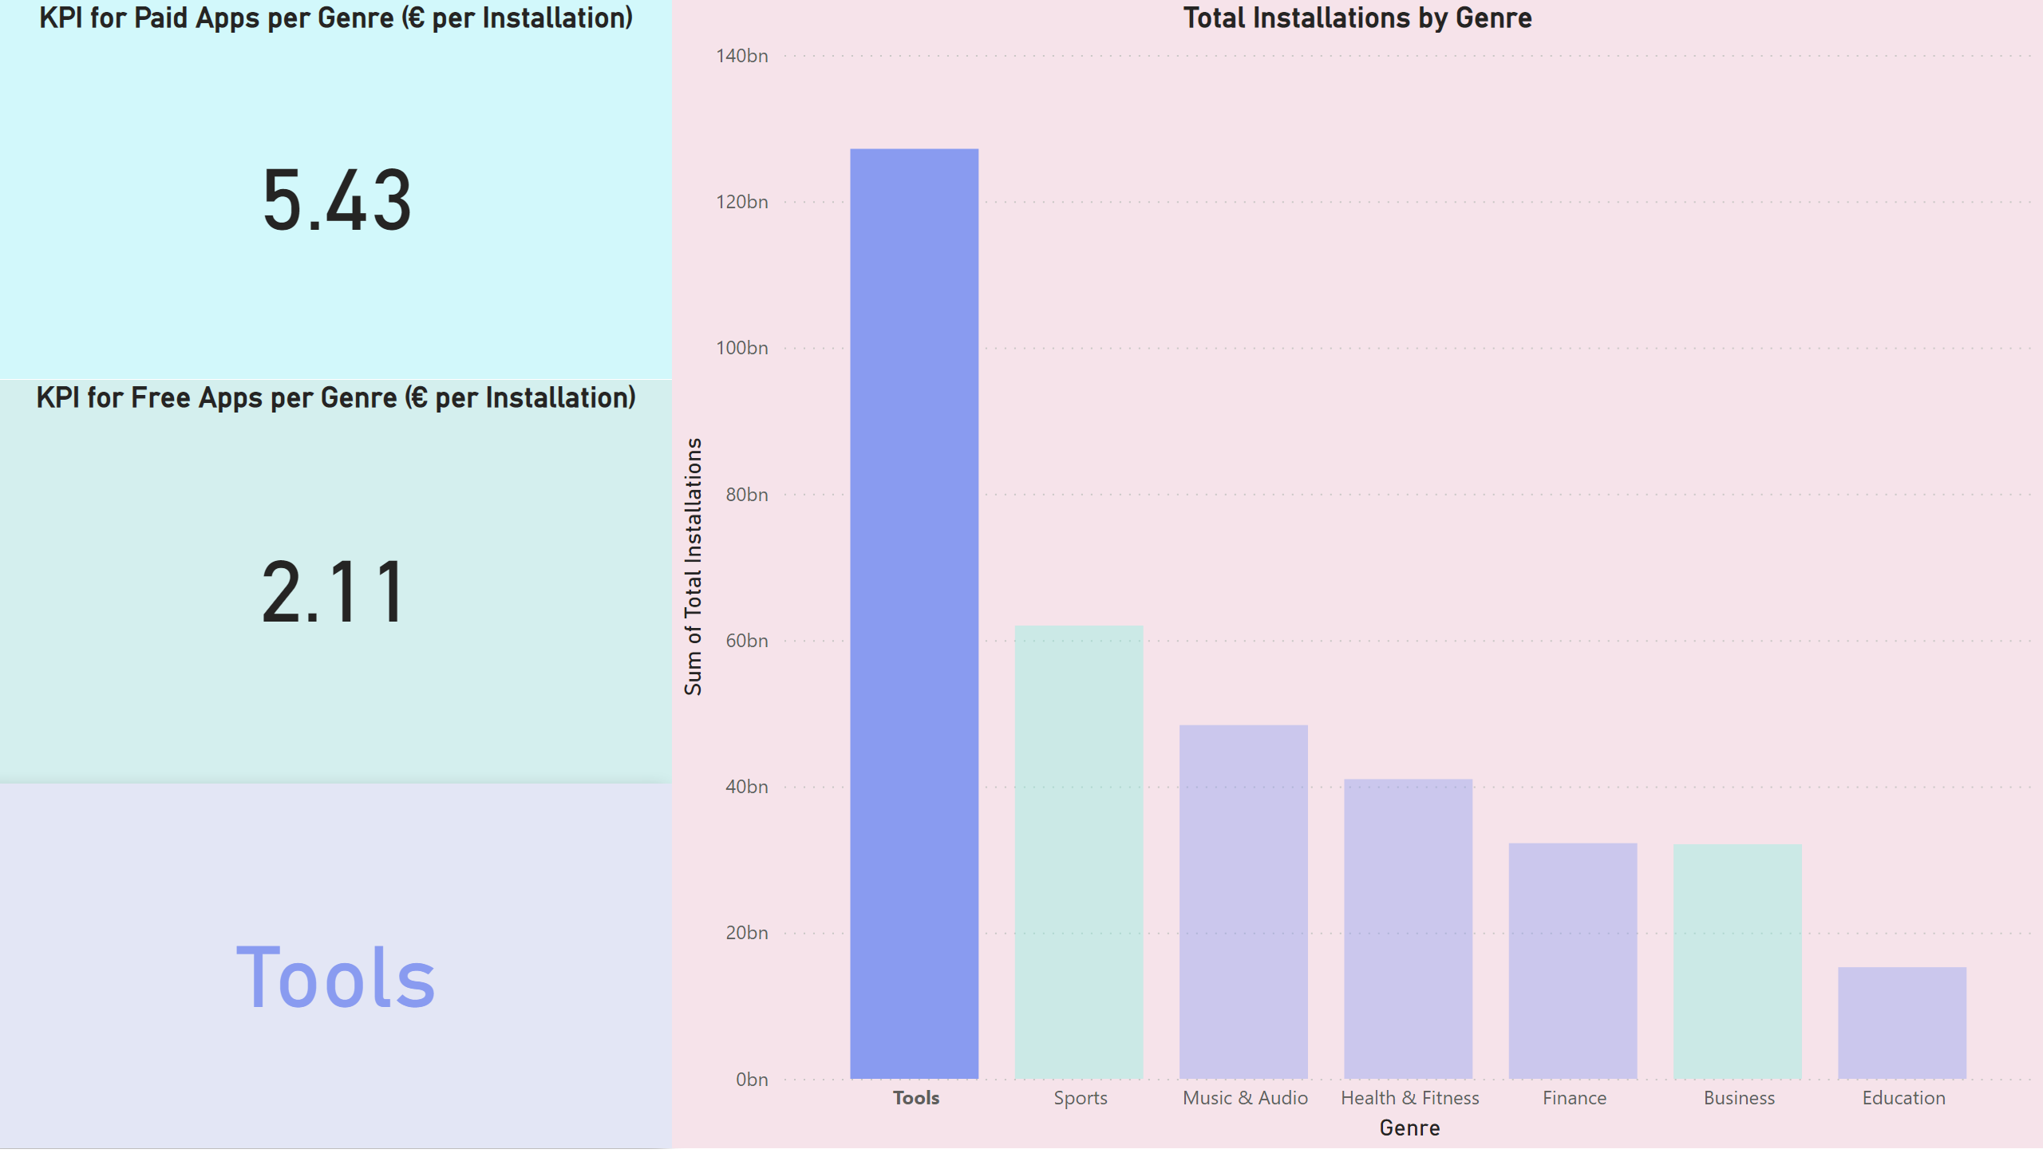
Dash 5 - KPIs
Notes:
KPI for Paid Apps per Genre (€ per Installation)
No alt text provided
KPI for Free Apps per Genre (€ per Installation)
No alt text provided
card
No alt text provided
Total Installations by Genre
No alt text provided

Slide 26
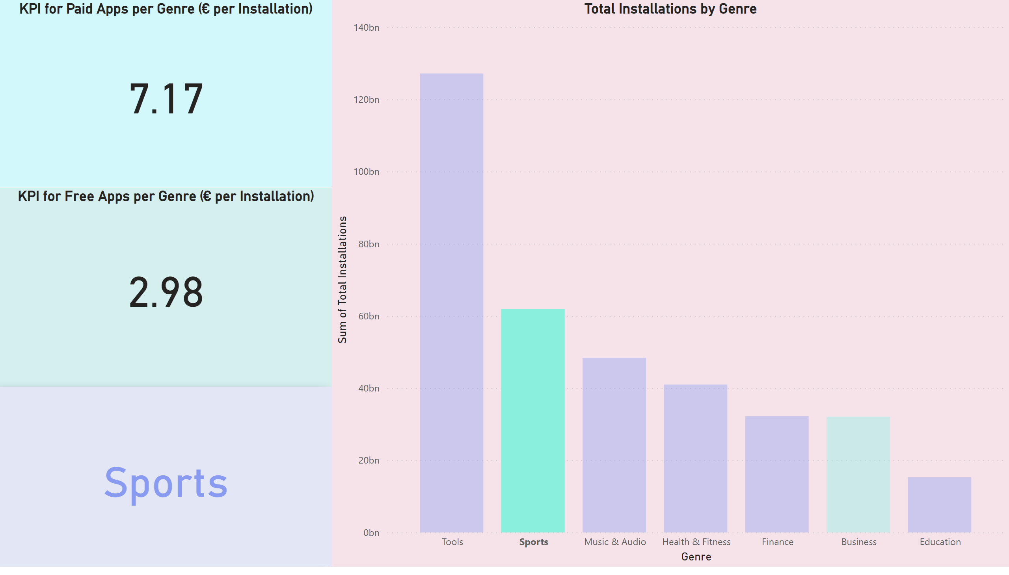
Dash 5 - KPIs
Notes:
KPI for Paid Apps per Genre (€ per Installation)
No alt text provided
KPI for Free Apps per Genre (€ per Installation)
No alt text provided
card
No alt text provided
Total Installations by Genre
No alt text provided

Slide 27
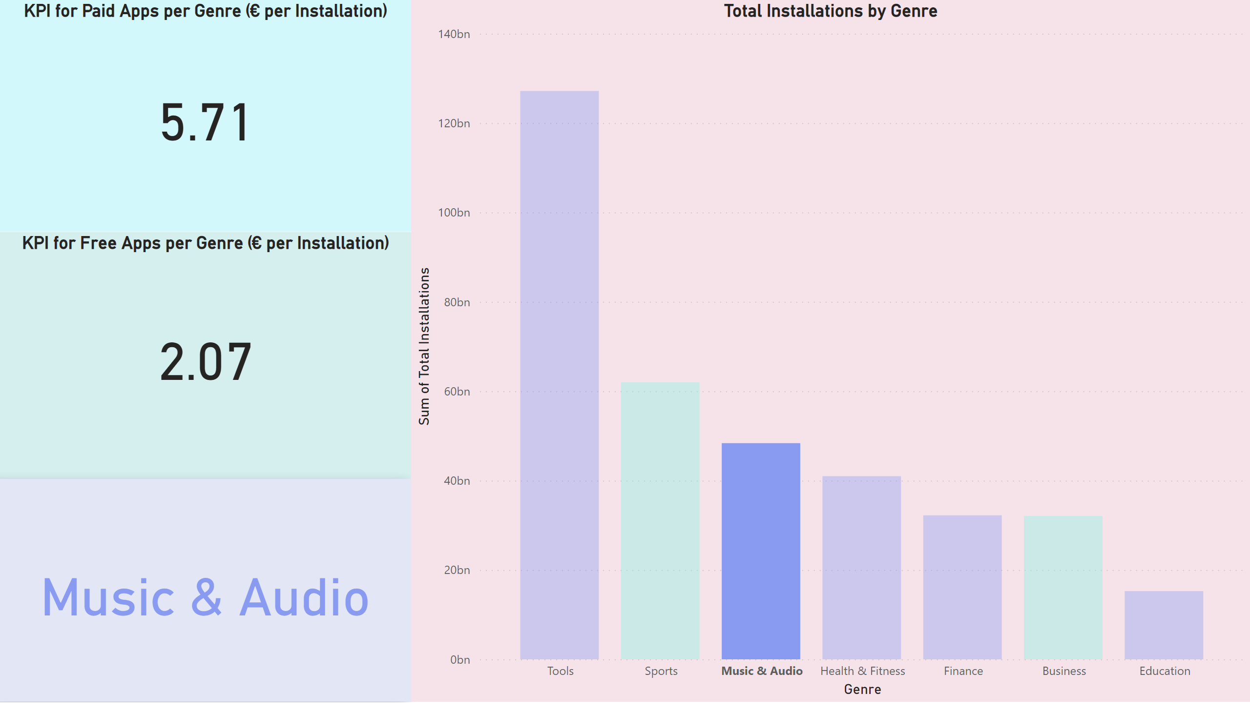
Dash 5 - KPIs
Notes:
KPI for Paid Apps per Genre (€ per Installation)
No alt text provided
KPI for Free Apps per Genre (€ per Installation)
No alt text provided
card
No alt text provided
Total Installations by Genre
No alt text provided

Slide 28
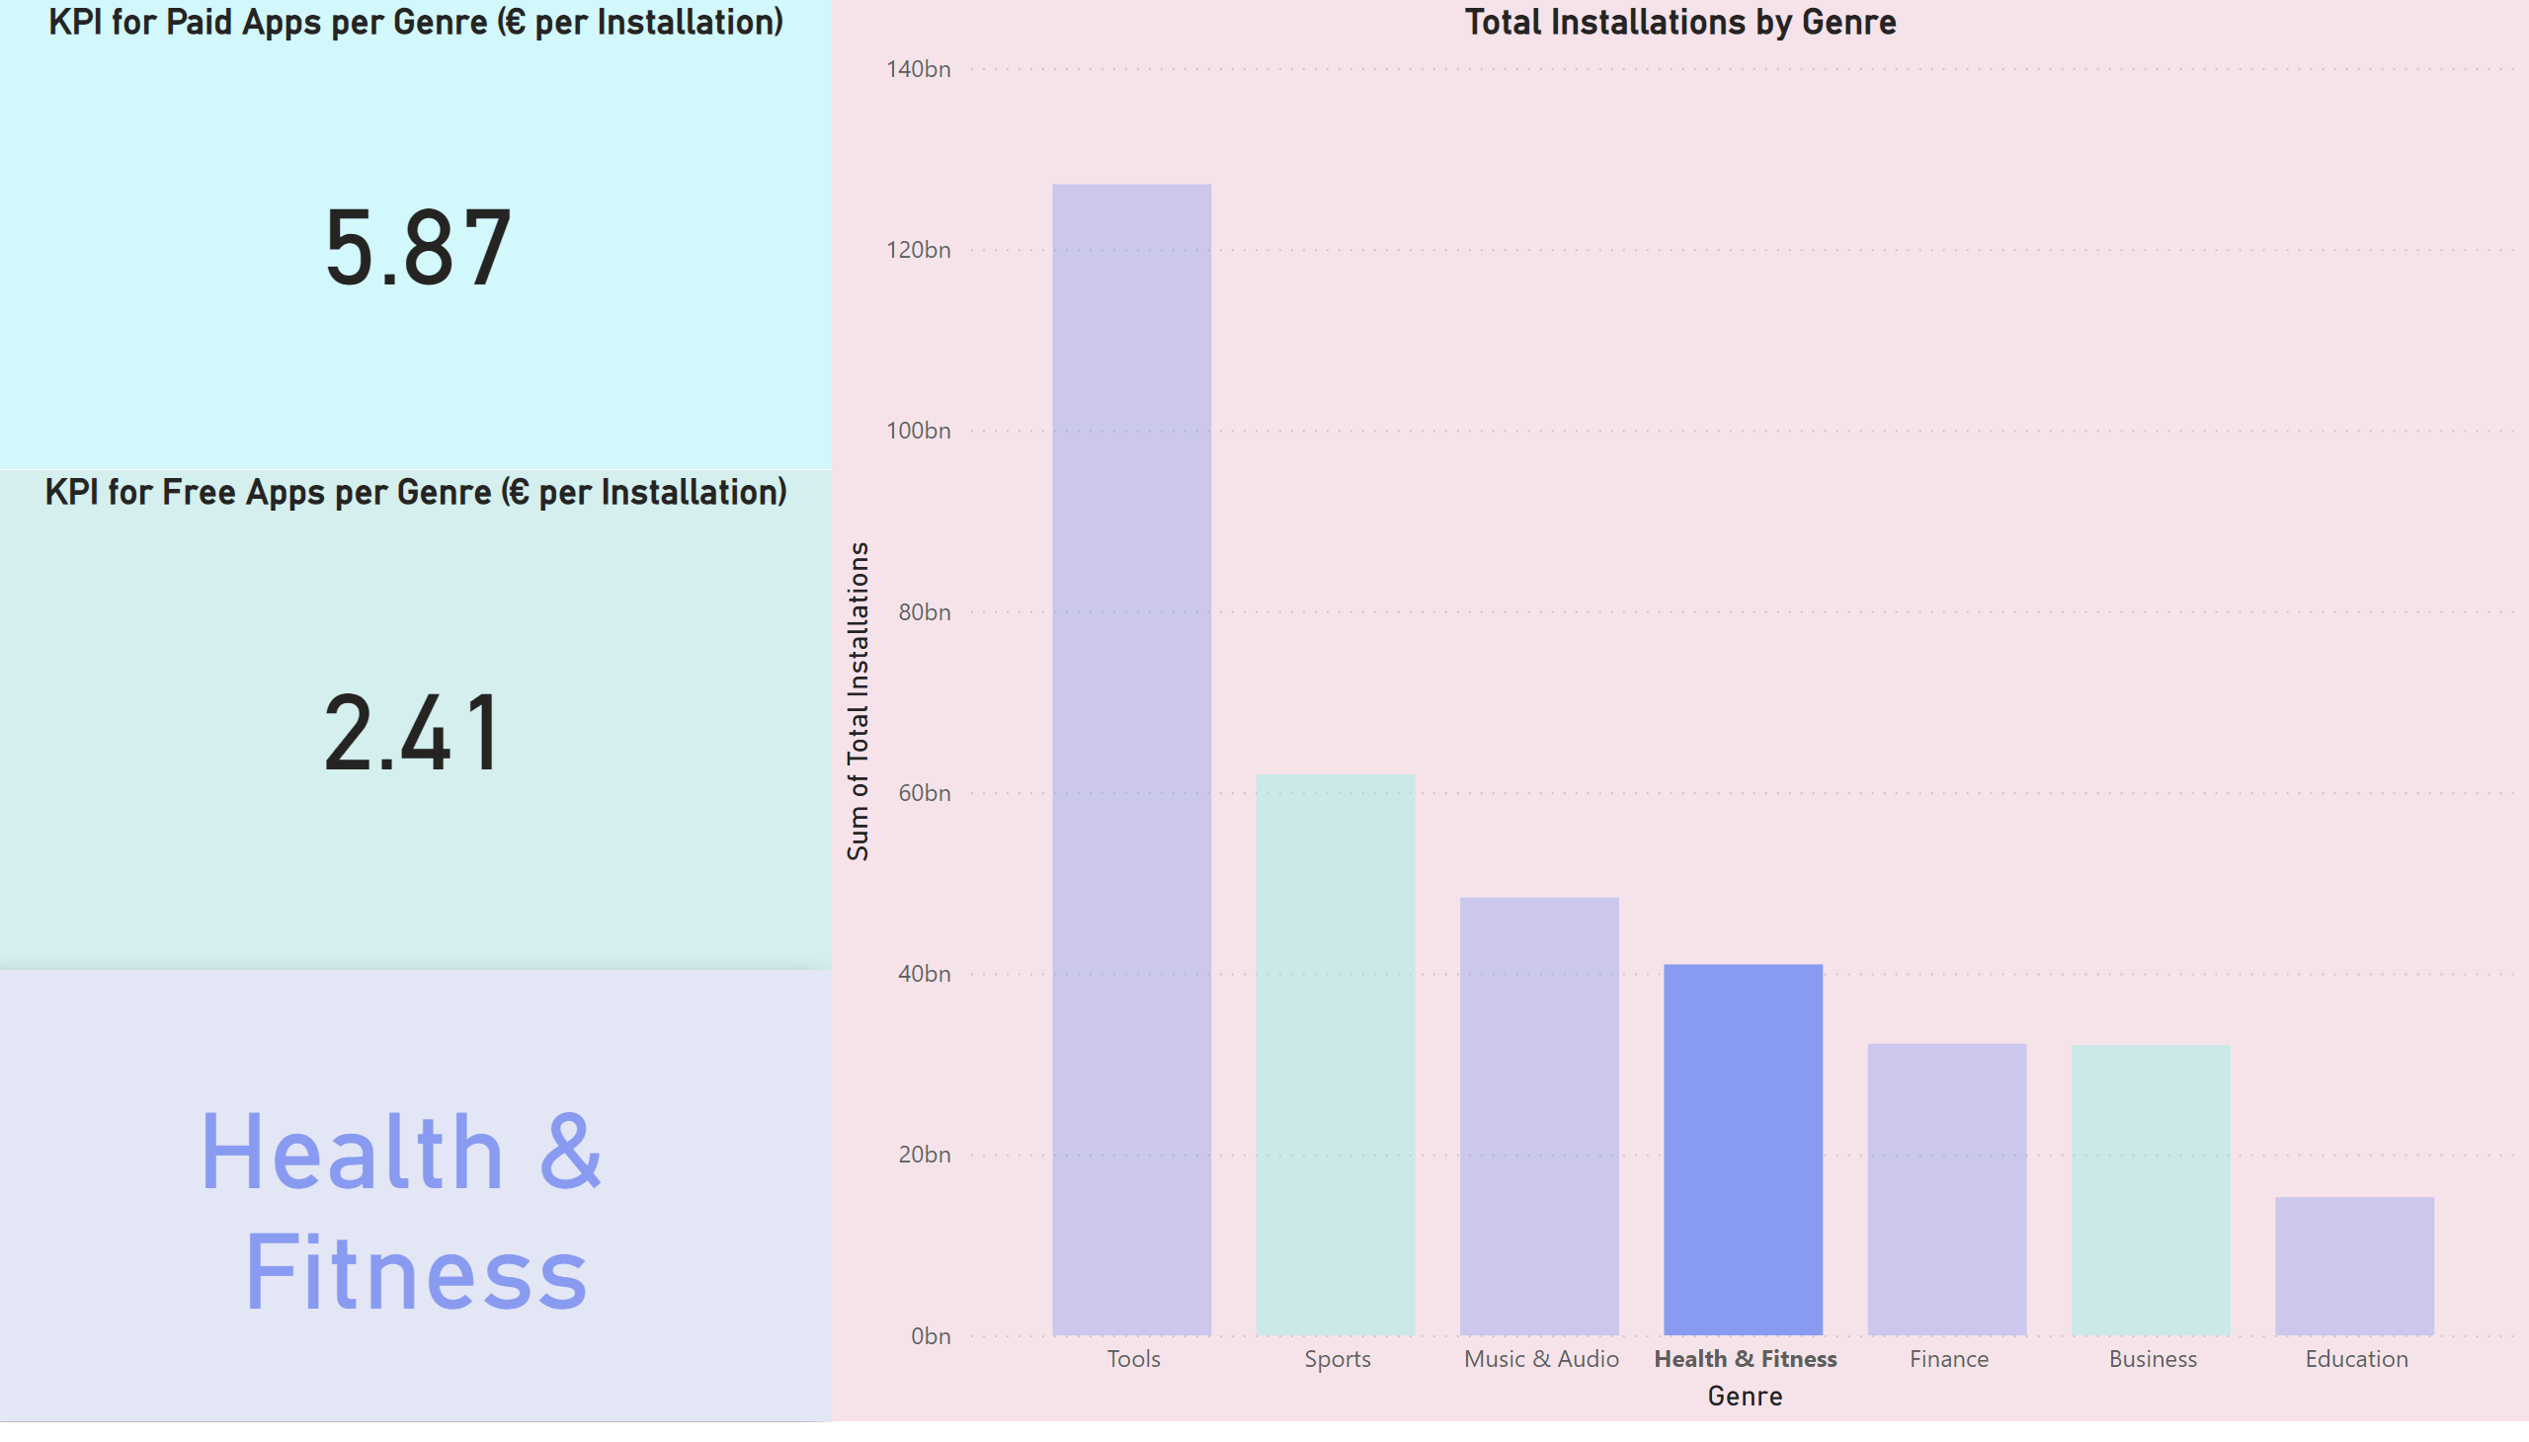
Dash 5 - KPIs
Notes:
KPI for Paid Apps per Genre (€ per Installation)
No alt text provided
KPI for Free Apps per Genre (€ per Installation)
No alt text provided
card
No alt text provided
Total Installations by Genre
No alt text provided

Slide 29
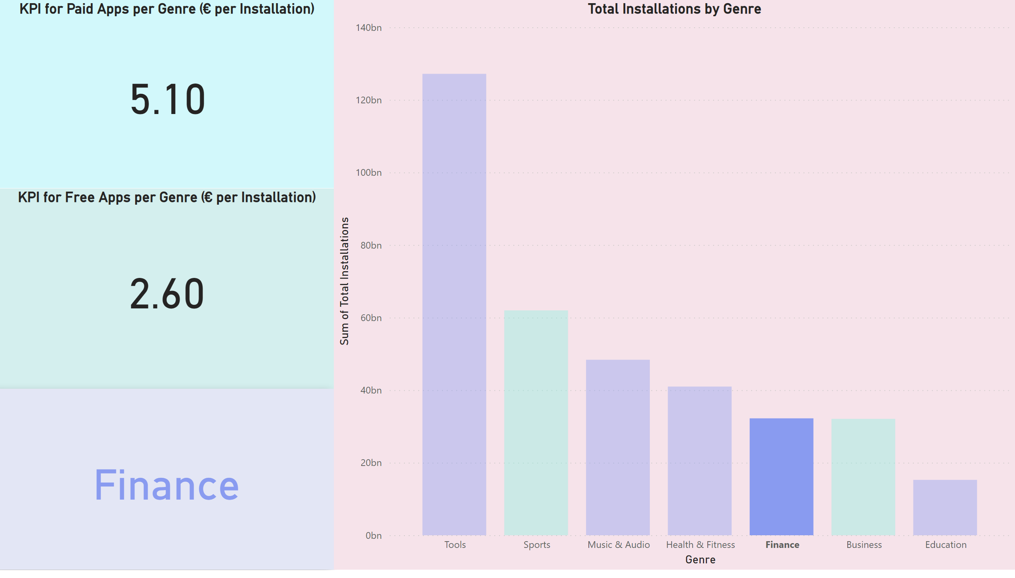
Dash 5 - KPIs
Notes:
KPI for Paid Apps per Genre (€ per Installation)
No alt text provided
KPI for Free Apps per Genre (€ per Installation)
No alt text provided
card
No alt text provided
Total Installations by Genre
No alt text provided

Slide 30
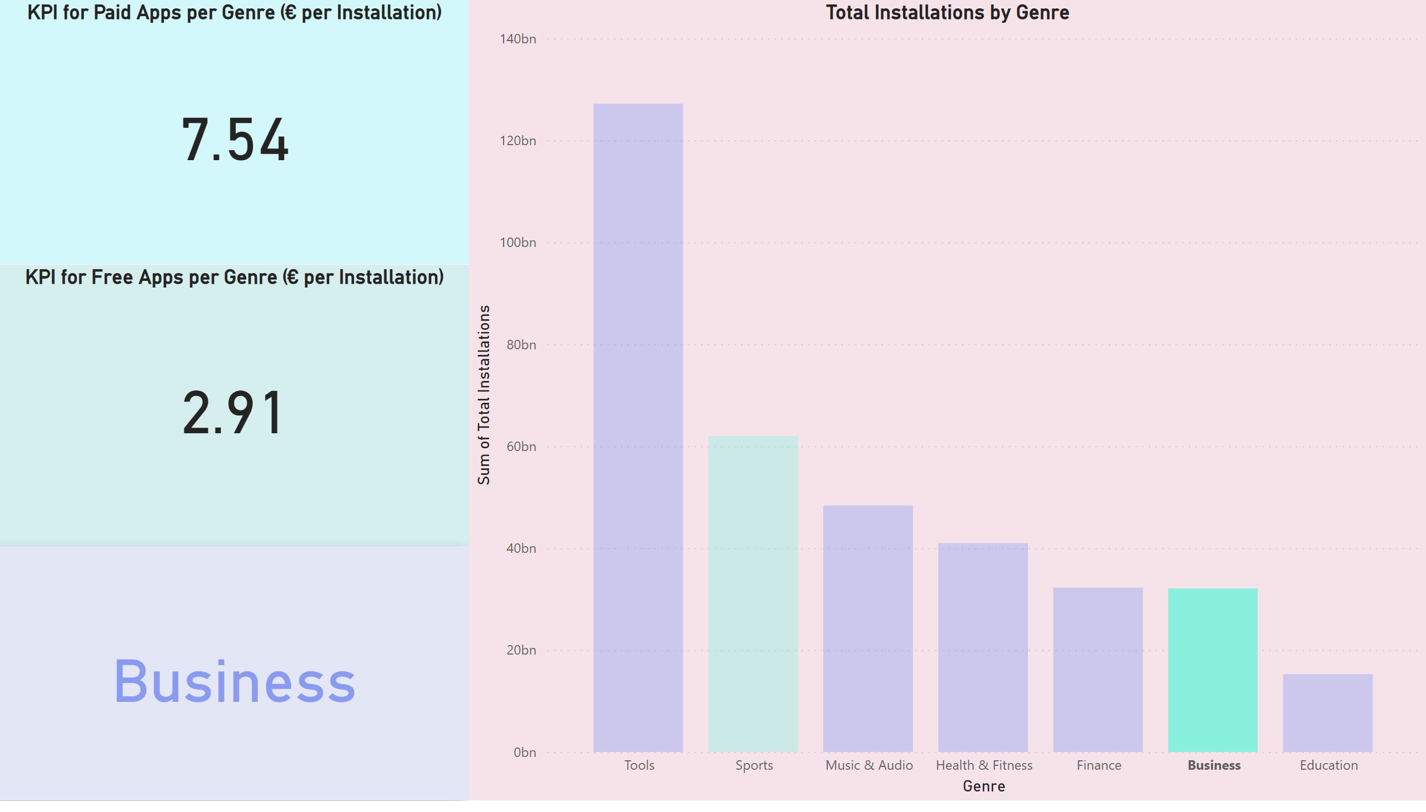
Dash 5 - KPIs
Notes:
KPI for Paid Apps per Genre (€ per Installation)
No alt text provided
KPI for Free Apps per Genre (€ per Installation)
No alt text provided
card
No alt text provided
Total Installations by Genre
No alt text provided

Slide 31
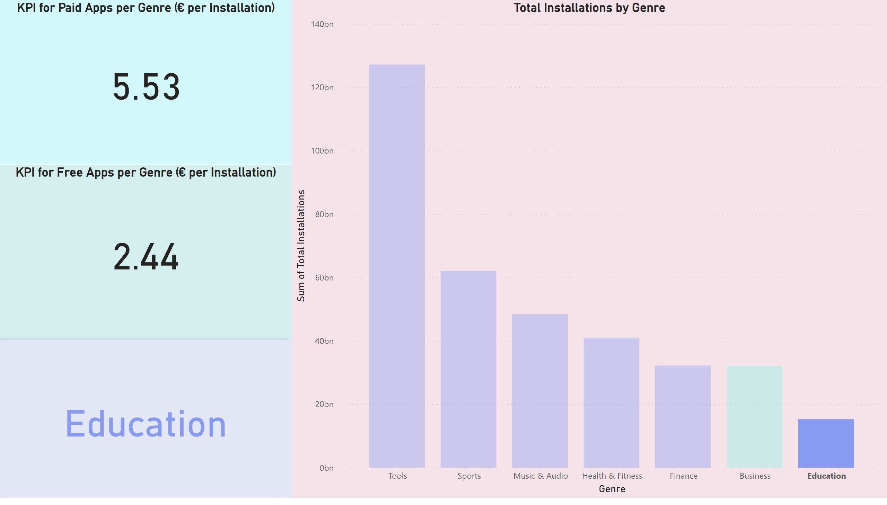
Dash 5 - KPIs
Notes:
KPI for Paid Apps per Genre (€ per Installation)
No alt text provided
KPI for Free Apps per Genre (€ per Installation)
No alt text provided
card
No alt text provided
Total Installations by Genre
No alt text provided

Slide 32

Dash 5 - KPIs
Notes:
KPI for Paid Apps per Genre (€ per Installation)
No alt text provided
KPI for Free Apps per Genre (€ per Installation)
No alt text provided
card
No alt text provided
Total Installations by Genre
No alt text provided

Slide 33
Dash 5 - KPIs
Notes:
KPI for Paid Apps per Genre (€ per Installation)
No alt text provided
KPI for Free Apps per Genre (€ per Installation)
No alt text provided
card
No alt text provided
Total Installations by Genre
No alt text provided

Slide 34
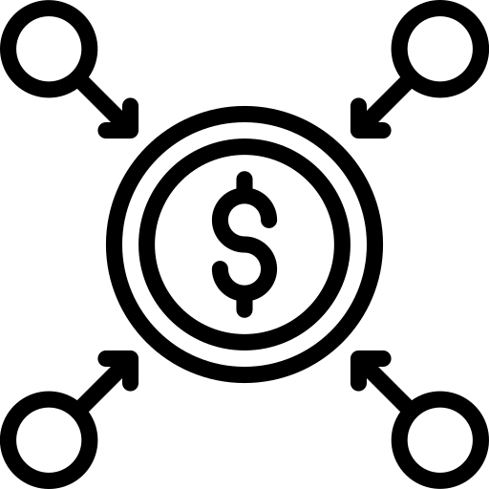



Analysis Summary
Genre’s Popularity
Free & Paid Apps
Tools, Education, Health & Fitness, Sports, Business, Music & Audio
Free installation charge apps are more popular with Tools and Sports being the most successfully commercial ones
Profit Sources
Profitability Key Performance Indicators
Installation price profit, In application purchases for additional functionalities
The most profitable genres are Sports and Business with Sports being a more popular choice for free app launching category

Slide 35





Click to Add Icon Slide Title Here
60bn Installations of Sports Applications
316bn euros installation profit for Paid Sports Applications
Numbers Speak for Sports
178bn euros In App Purchases profit for both Free & Paid Sports Applications
Key Profitability Indicator 7.17 euros per installation for Paid Sports Applications & 2.98 euros per installation for Free Sports Applications

Slide 36


“If your plans don’t include mobile, your plans are not finished”
Wendy Clark, Coca-Cola Co.

Slide 37
Thank you for your attention!

